Slide 1
Threads
Chapter 4 – William Stallings

Slide 2
A Process
Recall from Chapter 3, a process is a program in execution; it is a unit of execution
A program owns resources:
A process executes a program, which is supposed to be in memory; a process includes (virtual) address space to hold process image
A process follows an execution path that may be interleaved with other processes
Process has an execution state (Ready, Run, Blocked), and a dispatching priority; it is scheduled/dispatched by OS

Slide 3
Threads
The unit of dispatching is referred to as a thread or lightweight process; it consists of
Program counter
Register set
Stack space
The unit of a resource ownership is referred to as a process or task
A traditional (or heavy-weight) process = task with one thread.
Multithreading – the ability of an OS to support multiple, concurrent paths of execution within a single process

Slide 4
Thread
A thread shares with its peer threads its
Code section
Data section
Operating-system resources

Slide 5
Threads
In a multi-threaded task, while one thread is blocked and waiting, a second thread in the same task can run.
Threads provide a mechanism that allows sequential processes to make blocking system calls while also achieving parallelism.

Slide 6
Single threaded approach
Only one thread of execution in each process
E.g., MS-DOS

Slide 7
Multithreaded approach
An application is multithreaded in which there are multiple threads of execution
OS supports multithreaded applications

Slide 8
Threads
Each thread has its own
State (ready, running, or blocked)
Program Counter
Thread context
Some per thread static storage for local variables
Thread shares the memory and other resources allocated to the process to which it belongs
Code section
Data section
Operating system resources

Slide 9
Single and Multithreaded processes
Data
Code
Files
Code
Data
Files
Registers
Stack
Registers
Registers
Registers
Stack
Stack
Stack
Thread

Slide 10
One or more threads in a Process
Each thread has
An execution state – running, ready, wait
Thread context
A stack
Some per thread static storage for local variables
Access to the memory and resources of the process to which it belongs
All threads in a process share resources of the process

Slide 11
Threads – Benefits
Takes less time to create a new thread than a process
Takes less time to terminate a thread than a process
Switching between two threads is more economical than switching between processes
Threads improve efficiency in communication between programs

Slide 12
Threads – Benefits
Responsiveness
User response time may improve
Resource Sharing
Resources shared by many threads
Utilization of MP Architectures
Many processors can be used concurrently on different threads

Slide 13
Threads in a Single-user system
May be used for
foreground and background work
Increases the perceived speed of the application
Asynchronous processing
Asynchronous elements in a program can be implemented as threads
Increasing speed of execution
Multiple threads from the same process may execute simultaneously on a multiprocessor system
modular program structure

Slide 14
Thread Support
User-level threads supported above the kernel
Thread management done by user-level thread library
No kernel intervention for creation and scheduling of threads
Fast to create and manage
If one thread is blocked, others cannot progress
Examples
POSIX Pthreads
Mach C-threads
Solaris threads

Slide 15
Thread Support
Kernel supported threads
Kernel is responsible for creation, scheduling, management
Slower to create
If one thread of an application is blocked, others can be scheduled
Examples:
Windows 95/98/NT/2000
LINUX

Slide 16
Threads support
In Kernel supported threads
Scheduling and dispatching is done on a thread basis
Most of the state information dealing with execution is maintained in thread-level data structures
Suspending a process involves suspending all threads of the process
Termination of a process terminates all threads within the process

Slide 17
Thread states
The key states for a thread are:
Ready
Running
Blocked
Operations that change a thread state
Spawn
Block
Unblock
Finish

Slide 18
Multithreading Example
I/O
request
I/O
Done
Time slice
expires
Th 1, Pr 1
Running Blocked Ready Running Ready
Time slice
expires
Th 2, Pr 1
Ready Running Ready
Ready Running
Th 1, Pr 2
New Process
created

Slide 19
Thread Synchronization
It is necessary to synchronize the activities of the various threads
all threads of a process share the same address space and other resources
any alteration of a resource by one thread affects the other threads in the same process

Slide 20
Types of Threads
User Level Threads
All thread management is done by the application
Kernel not aware of existence of threads
Kernel Level Threads
Also called as kernel-supported threads or lightweight processes

Slide 21
Multithreading Models
Many-to-one
One-to-one
Many-to-Many

Slide 22
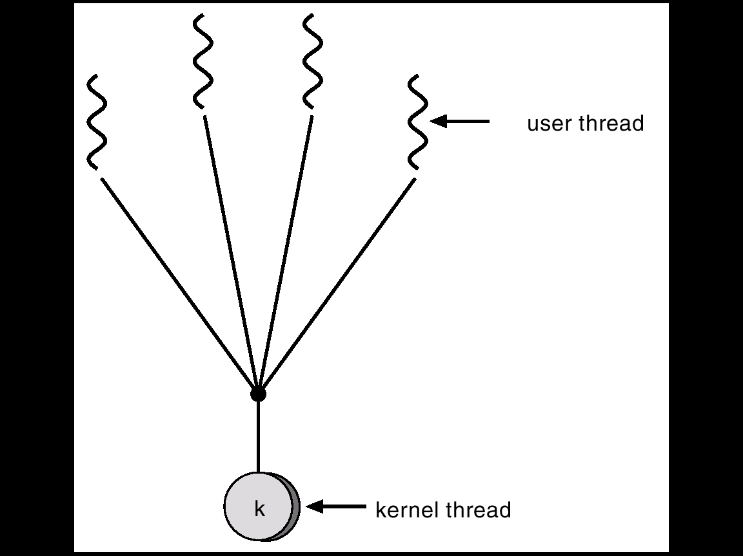
Many-to-One model
In this case many user level threads are mapped to a single kernel thread
Used on systems that do not support kernel-level threads

Slide 23
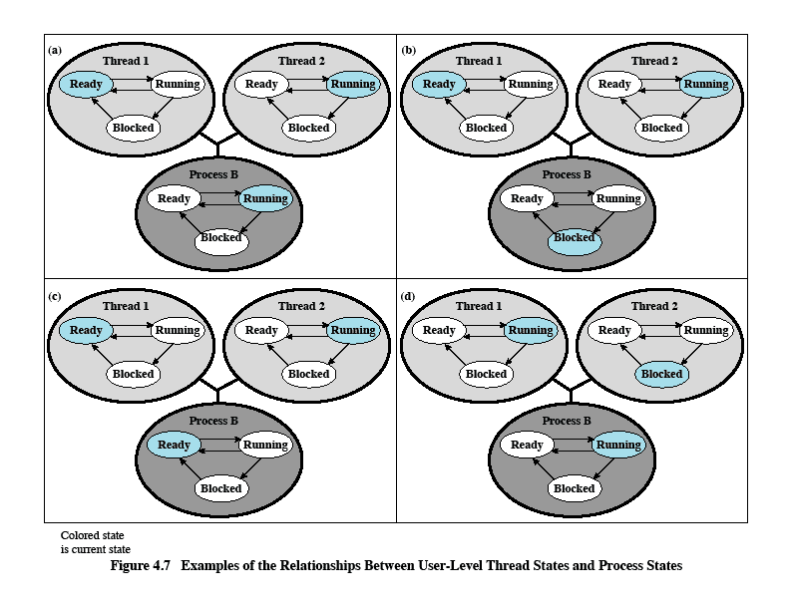
Relationships between ULT States and Process States

Slide 24
User-level threads
Advantages
Thread switching does not require kernel mode privileges
Saves overhead of 2 mode switches
Scheduling can be application specific
User-level threads can run on any OS
No changes are required to the underlying Kernel to support ULTs
Disadvantages
In a typical OS many system calls are blocking
When a thread is blocked on a system call, the entire process is blocked
A multithreaded application cannot take advantage of multiprocessing

Slide 25
Overcoming ULT disadvantages
Write the application using multiple processes instead of multiple threads
Lose the advantage of multithreading by causing too much overhead in process switching
Jacketing – convert a blocking system call into a non-blocking system call
e.g., Before actually making an I/O request, check status of the device; if device is busy, schedule another thread instead of making the I/O call

Slide 26
One-to-One Model
Each user-level thread maps to kernel thread.
Thread management is done by the kernel
No thread management done by the application
Kernel maintains context information for the process as a whole and for individual threads within the process
Examples
Windows 95/98/NT/2000
OS/2

Slide 27
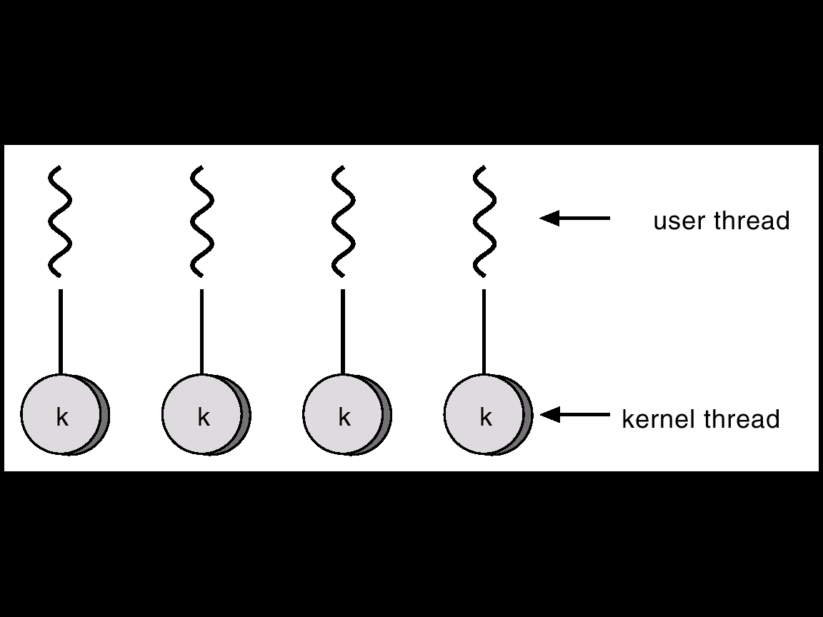
One-to-One Model

Slide 28
Advantages and Disadvantages
Advantages:
More than one thread of the same process can be scheduled by the kernel simultaneously on multiple processors
A process is not blocked if one thread of the process is blocked but some other thread is ready for execution
Kernel routines can be multithreaded
Disadvantage:
Transfer of control from one thread to another thread in the same process requires a switch to kernel mode

Slide 29
Many-to-Many Model
Thread creation is done in the user space.
Allows many user level threads to be mapped to many kernel threads.
Bulk of scheduling and synchronization of threads is by the application
Example: Solaris

Slide 30
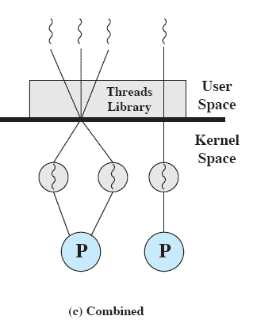
Many-to-Many Model

Slide 31
Relationship between threads and processes
Many-to-one: Multiple threads may be created and executed within a process – Solaris, Linux, OS/2
One-to-one: Each process has only one thread of execution – traditional process implementation
Many-to-many: Combines attributes of many-to- one and one-to-many -- TRIX

Slide 32
Applications that benefit from multicore resources
Multithreaded native applications
Characterized by having a small number of highly threaded processes
Multiprocessing applications
Characterized by the presence of many single-threaded processes
Java applications
The language facilitates multithreaded applications
Java virtual machine is a multithreaded process
Application servers
Multi-instance applications
Multiple instances of the application can run in parallel

Slide 33
Linux Tasks
A process in Linux is referred to as a Task
It is represented by a data structure called task_struct
Some of its fields are:
State (run, ready, suspended, stopped, zombie)
Scheduling information
Normal or real time; priority; time-slice
Identifiers
Are used to assign resource access privileges
Interprocess communication
Links
To parent, to siblings, and to children
Times and timers
File System
Address Space
Process specific context
The registers and stack information that constitute the context of this process

Slide 34
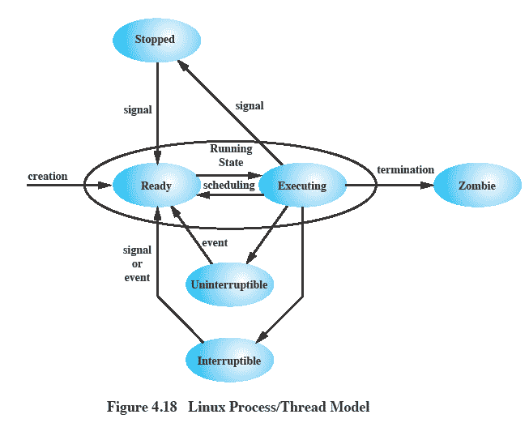
Linux Process/Thread Model

Slide 35
Linux Threads
No distinction between processes and threads
Threads mapped to kernel-level processes
A new process is created by copying the attributes of the parent process
The process can be cloned so that it shares resources
The clone() system call creates separate stack spaces for each process

Slide 36
Summary
User-level threads
created and managed by a threads library that runs in the user space of a process
a mode switch is not required to switch from one thread to another
only a single user-level thread within a process can execute at a time
if one thread blocks, the entire process is blocked
Kernel-level threads
threads within a process that are maintained by the kernel
a mode switch is required to switch from one thread to another
multiple threads within the same process can execute in parallel on a multiprocessor
blocking of a thread does not block the entire process
Process/related to resource ownership
Thread/related to program execution

